Slide 4






TABLE OF CONTENT
Background
Study Literature
Testing
Result and Analysis
Conclusion
2 July 2020

Slide 5




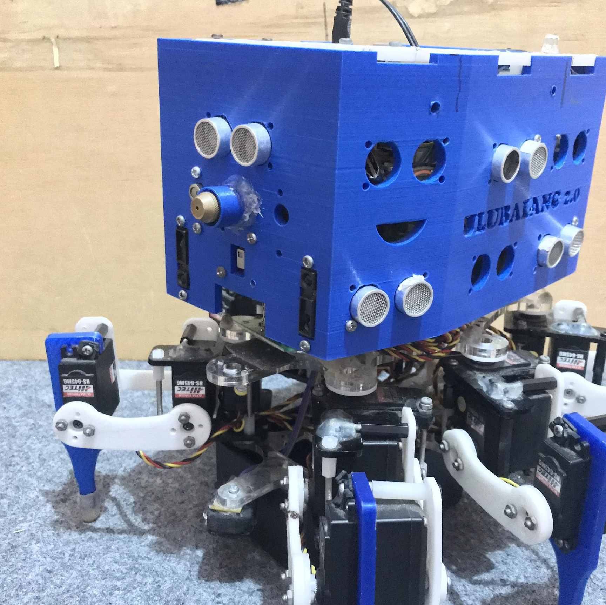

BACKGROUND
PID Control
Obstacle Avoidance
Ulubalang Robot’s KRPAI Institut Teknologi Del
The Robot have lack of navigation
Gave solution of these problems
Mapping Labyrinth
2 July 2020

Slide 8
OBSTACLE AVOIDANCE

Slide 10


KARNAUGH MAP
Developed by Willard V. Quine (1952)
Extended by Edward J. McCluskey (1956)
Functionally identical to Karnaugh Map
Gives a deterministic way to check that the minimal form of a Boolean function has been reached
Quine McCluskey algorithm can dealing with more than four variables but has a limited range of use
KARNAUGH MAP
Was founded by Maurice Karnaugh (1952)
Simplified by Edward Veitch (1953)
Reduce the need for extensive calculation
Rapid identification and elimination of potential race condition
Karnaugh maps are used to simplify real-world logic requirements so that they can be implemented using a minimum number of physical logic gates
QUINE MCCLUSKEY
2 July 2020
Notes:
The Karnaugh map (KM or K-map) is a method of simplifying Boolean algebra expressions. Maurice Karnaugh introduced it in 1953^{[1][2]} as a refinement of Edward Veitch's 1952 Veitch chart,^{[3][4]} which actually was a rediscovery of Allan Marquand's 1881 logical diagram aka Marquand diagram'^{[4]} but with a focus now set on its utility for switching circuits.'^{[4]} Veitch charts are therefore also known as Marquand–Veitch diagrams,'^{[4]} and Karnaugh maps as Karnaugh–Veitch maps (KV maps).
The Karnaugh map reduces the need for extensive calculations by taking advantage of humans' pattern-recognition capability.^{[1]} It also permits the rapid identification and elimination of potential race conditions.
Karnaugh maps are used to simplify real-world logic requirements so that they can be implemented using a minimum number of physical logic gates. A sum-of-products expression can always be implemented using AND gates feeding into an OR gate, and a product-of-sums expression leads to OR gates feeding an AND gate.^{[8]} Karnaugh maps can also be used to simplify logic expressions in software design. Boolean conditions, as used for example in conditional statements, can get very complicated, which makes the code difficult to read and to maintain. Once minimised, canonical sum-of-products and product-of-sums expressions can be implemented directly using AND and OR logic operators.^{[9]} Diagrammatic and mechanical methods for minimizing simple logic expressions have existed since at least the medieval times. More systematic methods for minimizing complex expressions began to be developed in the early 1950s, but until the mid to late 1980s the Karnaugh map was the most common used in practice.^{[10]}
The Quine–McCluskey algorithm (QMC), also known as the method of prime implicants, is a method used for minimization of Boolean functions that was developed by Willard V. Quine in 1952^{[1][2]} and extended by Edward J. McCluskey in 1956. The Quine–McCluskey algorithm is functionally identical to Karnaugh mapping, but the tabular form makes it more efficient for use in computer algorithms, and it also gives a deterministic way to check that the minimal form of a Boolean function has been reached. It is sometimes referred to as the tabulation method.
The method involves two steps:
Finding all prime implicants of the function.
Use those prime implicants in a prime implicant chart to find the essential prime implicants of the function, as well as other prime implicants that are necessary to cover the function.

Slide 15
KARNAUGH MAP
Methodology for testing:
Trial and Error (Using Quine McCluskey Algorithm)
2 July 2020

Slide 16



KARNAUGH MAP
The data that collected is from movement of robot (as y-axis) and how much step of robot was done (as x-axis).
There is one default movement as a reference movement. The reference movement made from robot’s dimensions against the path.
Step is calculate based on ripple gait movement of the robot. If the ripple movement is done, then step calculate increase by one
2 July 2020

Slide 17
KARNAUGH MAP
Robot Movement Error For Trials Without Obstacle
Percobaan | Approx | Exact | Galat(%)
I | 79 | 90 | 12,22222222
II | 78 | 90 | 13,33333333
III | 72 | 90 | 20
2 July 2020

Slide 18
KARNAUGH MAP
2 July 2020
Notes:
From the three trials conducted previously, obtained the following data which is attached to the graph. On this graph, it can be seen that the red line represents the desired movement. From each experiment, there were a number of errors caused by several factors. One of them is the delay that occurs in the movement of the sensor system to the movement system.

Slide 21
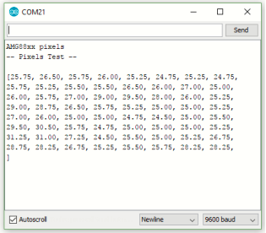
MAPPING LABYRINTH
Figure 16 Expected result of AMG8833
2 July 2020

Slide 22
MAPPING LABYRINTH
After arriving in room 2 and failing to detect fire, the robot cannot return to the initial room because the servo on the robot's leg is damaged and all the batery is broken.
2 July 2020

Slide 23
MAPPING LABYRINTH
Implementation using model based algorithms can be done, but requires precise calculations and has minimal errors so that the movement of the robot can actually be mapped by the robot
2 July 2020

